Slide 1
INDIAN PREMIER LEAGUE
ANALYSIS
2021-2023
BY
DURGA KUDALE

Slide 2
FIRST EDITION
2008
INTRODUCTION
FORMAT
The Indian Premier League (IPL) is a professional Twenty20 cricket league in India, widely regarded as one of the most popular and lucrative T20 leagues globally. Launched in 2008 by the Board of Control for Cricket in India (BCCI), the IPL features franchise teams representing different cities. Known for its high-octane cricket, star-studded line-ups, and innovative formats, the IPL has become a cricketing extravaganza, attracting top international players.
Twenty20
NUMBER OF TEAMS
TEN ( 10 )
ADMINISTRATOR
BCCI
( Board of Control for Cricket in India )
HEADQUARTERS
Cricket Centre, Churchgate,
Mumbai, Maharashtra

Slide 3

TEAM PLAYING
CHENNAI SUPER KINGS
MUMBAI INDIANS
DELHI CAPITALS
PUNJAB KINGS
GUJRAT TITANS
RAJASTHAN ROYALS
ROYAL CHALLENGERS BANGALORE
KOLKATA KNIGHT RIDERS
LUCKNOW SUPER GIANTS
SUNRISERS HYDERABAD

Slide 4
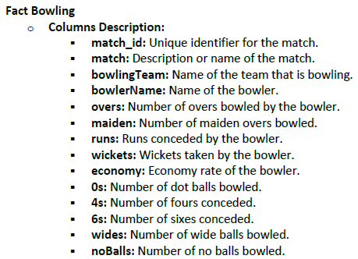
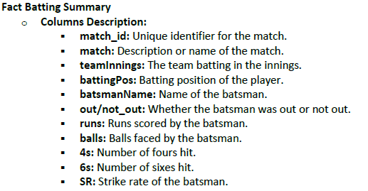
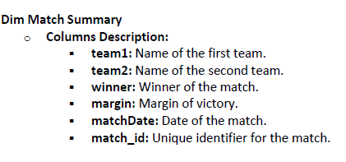
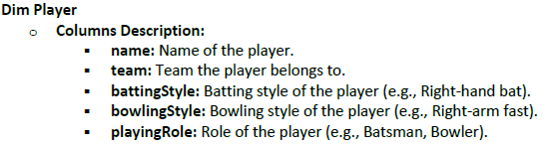
OBJECTIVES
The goal of this Power BI project is to analyse IPL (Indian Premier League) cricket data to gain insights into team and player performance, match outcomes, and various key metrics related to both batting and bowling. The analysis will be carried out using data from multiple related tables, providing a comprehensive view of the tournament's dynamics.
DATASETS

Slide 5
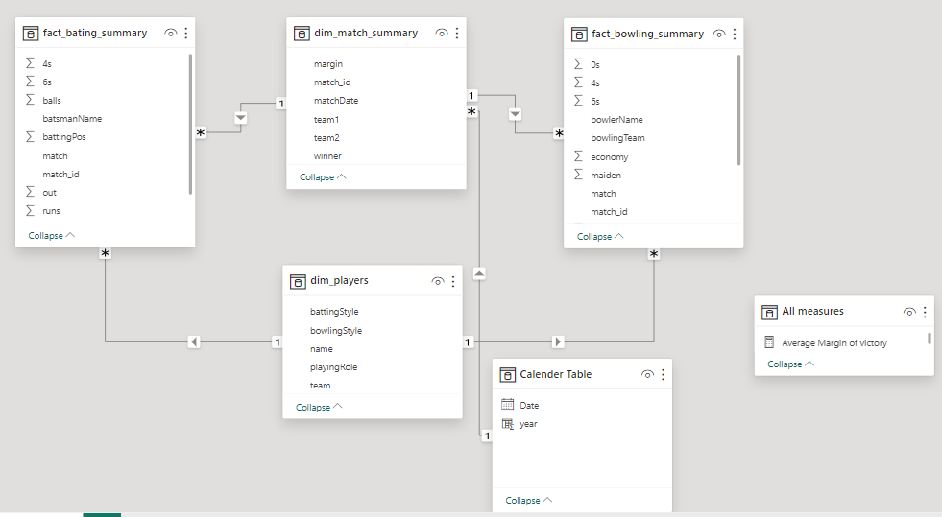
DATA MODELLING
Extract all tables into Power Query
Perform data cleaning in Power Query Editor
Load data to Power Bi
Create relationship between 4 tables.

Slide 6
IPL ANALYSIS DASHBOARD

Slide 7
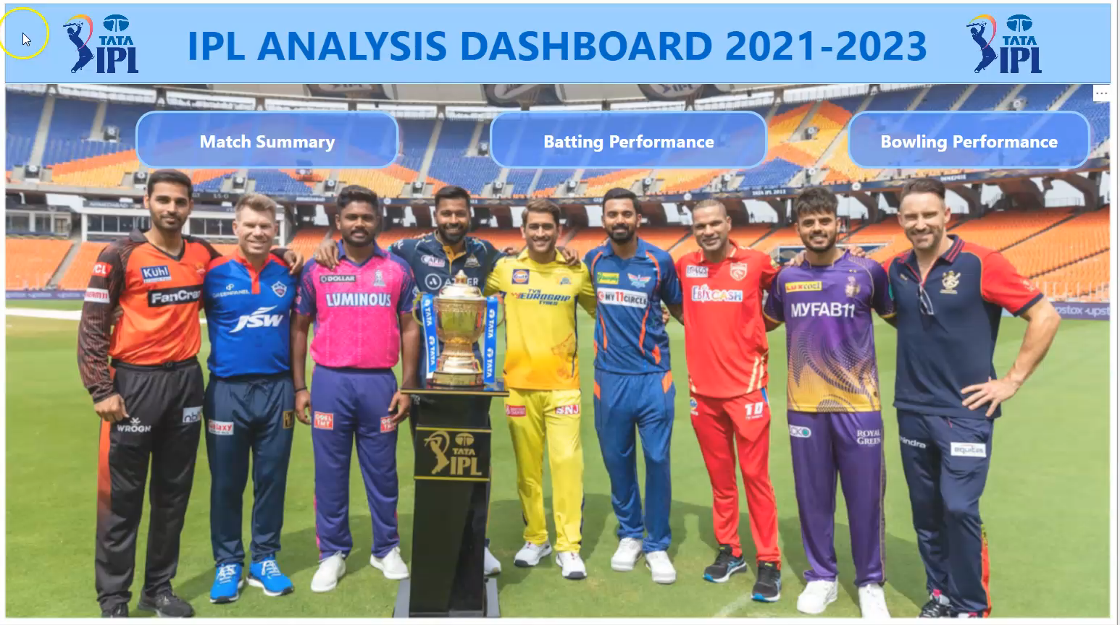
IPL ANALYSIS DASHBOARD

Slide 8

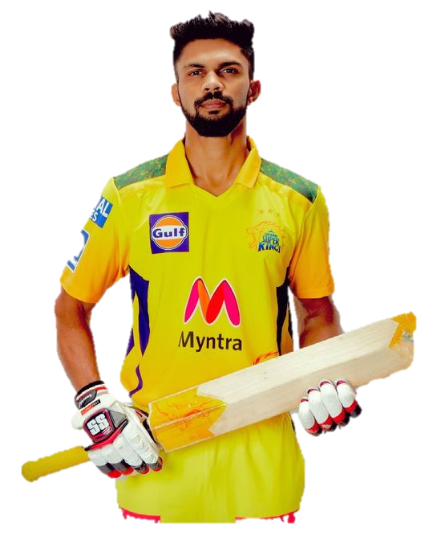






IPL RECORDS
ORANGE CAP HOLDER
RUTURAJ GAIKWAD
JOS BUTTLER
SHUBMAN GILL
635
863
890
Runs
Runs
Runs
In 2021
In 2022
In 2023
PURPLE CAP HOLDER
HARSHAL PATEL
YUZVENDRA CHAHAL
MOHAMMED SHAMI
32
27
28
Wickets
Wickets
Wickets
In 2021
In 2022
In 2023

Slide 9


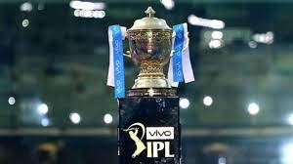
IPL CHAMPIONS (2021-2023)
In 2021 CSK won by 27 runs beating KKR.
In 2023 CSK won by 5 wickets defeated Gujarat Titans
In 2022, Gujarat Titans won by 7 wickets defeated Rajasthan Royals

Slide 10
THANK YOU

